Slide 1
Design of a Smart Step Counting System
Zachary Murtishi, University of Rhode Island

Slide 2
Part I: Step counting

Slide 3
What is a pedometer?
A pedometer is a device intended to count the number of steps performed by the wearer.
Pedometers can be a standalone device, or integrated into other devices such as smartphones, smart watches, health trackers, or even hearing aids. They may be implemented with mechanical counters or MEMS sensors and algorithms, though they are most commonly implemented with electronic circuits today.

Slide 4
Current approaches to step counting
Pedometers of the past were often mechanical devices, though virtually all commercially-available pedometers today are electronic
Traditional algorithms used for step counting on many commercially-available pedometers
Algorithms use data sourced from a MEMS accelerometer, gyroscope, or combination (IMU)
Algorithms can be be simple or they can be highly-optimized
Academic studies have experimented with the use of neural networks and machine learning techniques for step counting
Several examples, but these experiments are often not deployed for use in real time
Very little use in commercial products
Starkey Livio AI hearing aids claims to use AI, but no other information available

Slide 5
Examples of step counting algorithms
Zero crossing detection
Windowed peak detection
Autocorrelation

Slide 6
Part II: A smart step counting algorithm

Slide 7
Using a neural network for step counting

Slide 8
Artificial neural networks

Slide 9
Two-step algorithm to count steps
Step 1: Motion classification
Using a one-second window of IMU data sampled at 10 Hz, perform motion classification to determine if the user is in motion.
Step 2: Zero crossing algorithm
If the motion classifier detects user motion, a zero crossing algorithm is run to determine the number of steps counted in the one-second window.
The zero crossing algorithm simply counts the number of zero crossings observed in the gyroscope’s Z axis data to determine the number of steps that occurred in that window.
Number of zero crossings = number of steps

Slide 10
Motion classifier
The motion classifier is a model trained to identify a user’s current motion type
Trained to detect idle behavior, active walking motion, and erratic motion (shaking)
Model was trained using real-world data collected with a user-worn gyroscope
Implemented using Keras in Python
Motion classifier uses separate neural networks for each gyroscope axis
Uses Y and Z axis of gyroscope to determine motion type
Softmax outputs of each neural network
Takes a 10-element timeseries vector as input
10 elements are sampled

Slide 11
Part III: Implementations of a smart step counting system

Slide 12
Hardware to implement a smart step counting system
A step counting algorithm is just one part of a step counting system, as motion data must be captured from user before the algorithm can act on it
This system must include wearable hardware to allow real-time data capture from a moving user
A step counting system must contain several elements that allow it to both collect data and perform the calculations required to execute the algorithm:
Sensors
Wireless communications hardware
Battery
CPU

Slide 13
Systems for “smart” step counting with neural networks
Two systems have been developed as a means to evaluate the use of artificial neural networks as a step counting solution
1. Raspberry Pi-based system
Pedometer implemented using Python scripts running on a single-board computer
2. Custom implementation
Pedometer implemented by an 8-bit microcontroller-based system
Both are intended to use the same machine learning model for step classification
System 1 (“Pi solution”) can perform classification on-board or off board
System 2 (“Custom solution”) requires an external host for classification due to a lack of computing power

Slide 14
Solution I: Raspberry Pi
Objective of this solution was to evaluate neural networks as a technique for step counting
Linux OS and ARM processor allow execution of Keras program to perform on-board classification of motion data, so classification may be performed both on and off the board.
Advantages
Allows use of high-level APIs and programming languages to implement pedometer and connectivity functions to speed up development time
Complete PCB with external interfaces to hardware accessories
Linux OS provides a familiar development environment
No client system required for operation
Disadvantages
Power-hungry! Pi demands 540 mA when CPU is idle.
OS and Python libraries are clunky and abstracted, true time-sensitive routines not possible due to pre-emption by system processes
Cost and complexity: far too much for what is required here!
Inclusion of extra hardware is clunky, only 40-pin header allows small-footprint expansion

Slide 15
Solution II: Custom hardware
Objective was to evaluate the use of PCB centered around an 8-bit microcontroller as a solution to issues faced by Raspberry Pi solution
Low processing power of microcontroller precludes on-board classification; all classification is performed off-board by another host.
Advantages
Bare-metal implementation allows programmer complete control over microcontroller’s CPU functions and peripherals
Timers, interrupts, serial hardware
Considerably lower power consumption
On-board power solution
Disadvantages
Client system required for operation
PCB cannot be purchased COTS and must be developed as a bespoke system
PIC18 software routines must be developed specifically for this application
Minimalist implementation means no on-board classification!

Slide 16
Client system
The client system connects to the pedometer through a wireless connection and is intended to perform motion classification
Optional for Pi solution, required for custom solution
Bluetooth Classic for Pi solution, Bluetooth Low Energy for custom solution
Client system features significantly more capable hardware than Pi Broadcom CPU and can perform classification in a shorter amount of time
Client software implementation is different between two solutions, but core functionality is retained
Implementation changes due to fundamental differences between Bluetooth Classic and Bluetooth Low Energy protocols

Slide 17
Raspberry Pi solution
Pi runs Python scripts to implement three main functions
Data polling
Collect data from Pi Sense Hat’s on-board IMU to characterize motion (10Hz)
Off-board communication
Bluetooth Classic link to laptop host to exchange motion data and classification results
Motion classification
Runs motion classifier on-board whenever a host is not connected over Bluetooth
Program attempts to take advantage of parallelism to minimize blocking delays from I/O and classification functions
Pi is a 4-core system: we want to make use of all hardware resources!
Uses Unix sockets and file I/O for inter-process communication between each component script
True parallel thread execution difficult due to Python Global Interpreter Lock

Slide 18
Software used by Raspberry Pi solution
Many Python libraries used for implementation of key components
Keras
High-level API for TensorFlow functions
Interface for neural networks in Python
Pybluez
Library allowing use of Bluetooth Classic functions in Python
No longer actively supported, but still works on Linux with Python 3.10
Allows implementation of RFCOMM sockets in Python program
Pi Sense Hat API
Provides software interfaces to Sense Hat hardware
RTIMU component of this API used for retrieving data from LSM9DS1 IMU

Slide 19
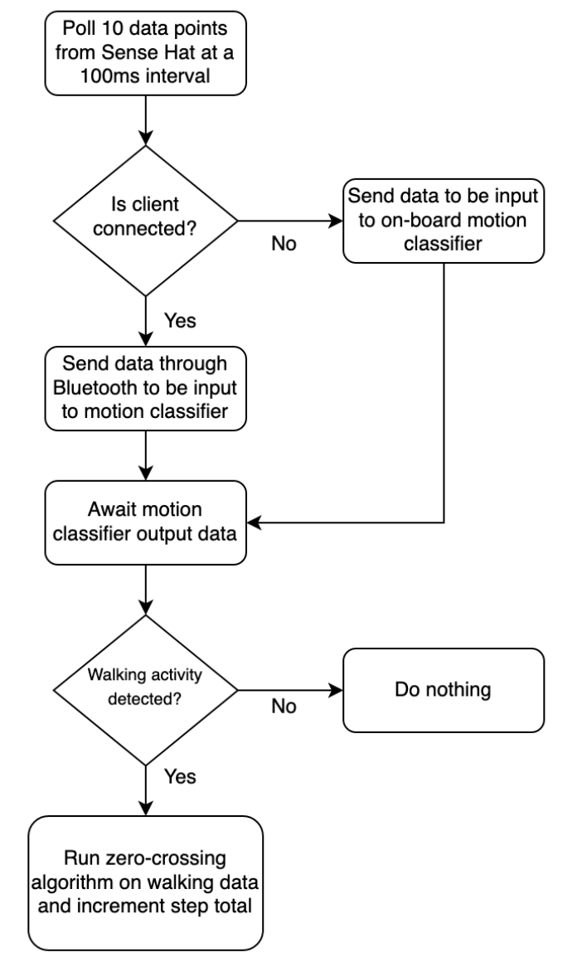
How the Pi solution works
Pi solution’s operation can be described by a simple flow chart

Slide 20
Hardware design considerations
The prototype solution’s Raspberry Pi core introduces challenges to portability due to the high power consumption required and lack of developer control over the hardware due to the operating system
Bare metal: a device that operates without the overhead of an operating system; program code is run directly by chip
The new solution shall be a bare-metal based solution in order to:
Allow the developer more control over software implementation
Processor interrupts, sleep states, timing
Lower power consumption
Back to basics: include only essential hardware to save power!
Improve real-time performance
No OS overhead, threads, etc.

Slide 21
In defense of removing on-board classification from custom solution
No need to put hardware for classification on custom solution, everyone already carries a powerful CPU in their pocket!
iOS/Android client application can replace the need for on-board hardware to perform motion classification
Same functions as client system / program
Many mobile processors contain dedicated machine learning hardware to accelerate classification
Example: iPhone neural engine
Application can make use of Android/iOS ML interfaces
CoreML for iOS, TensorFlow Lite for Android

Slide 22
Hardware solution trade study
Several options were considered to implement the hardware solution
Arduino Nano 33 BLE
Built-in Bluetooth hardware, IMU, and microcontroller
All-in-one solution, does not require significant hardware development
But not enough control over AVR processor w/ Arduino bootloader…
Limited control over interrupts, timers, low-power modes, etc.
ESP32 development boards
Built-in wireless interfaces and microcontroller
But power consumption is too high!
ESP32 cores run at high clock speeds (>80MHz)
Custom implementation
Design custom circuitry and fabricate own PCB to implement device
Add on-board power solution to enhance portability
Selected PIC18 for microcontroller as I am most familiar with that architecture and these devices tend to be cheap and readily available from major distributors
Powerful on-chip peripherals available (timer, hardware serial ports, external interrupts)
Core can run at 3.3V and operate at low clock speeds (<20 MHz) to save power

Slide 23
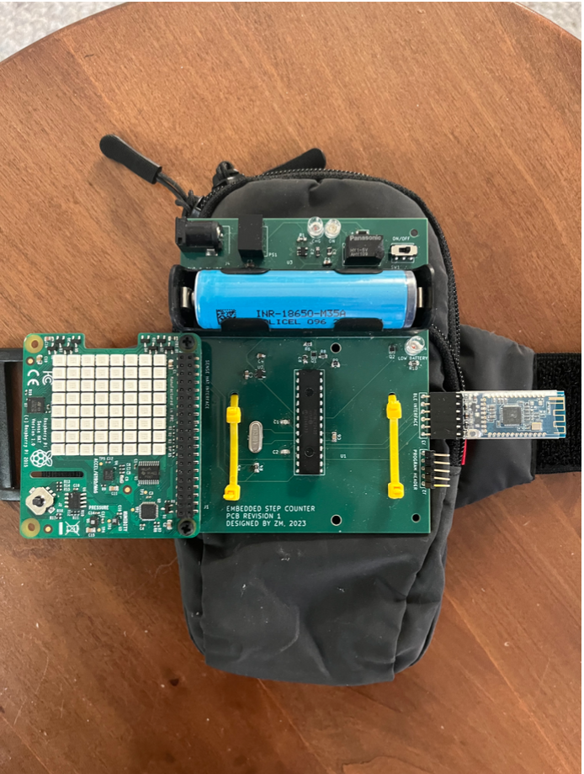
Hardware design
Microcontroller core: PIC18LF2420 @ 4 MHz
8-bit microcontroller with RISC instruction set, programmed in C
Power source: 18650 lithium-ion cell, 9V DC adapter
Uses standard barrel jack for external power / charging
Wireless connectivity: HM-10 Bluetooth Low Energy module
Complete PCB assembly integrated into design through serial port header
Sensor suite: Raspberry Pi Sense Hat
Intended for use with Raspberry Pi, but PIC18 microcontroller talks to LED matrix and LSM9DS1 IMU over I2C bus

Slide 24
Software required for custom solution
Unlike Pi solution, all software on the pedometer itself is packaged in the form of a unified C executable
Once again, Keras is used on the client side to perform motion classification on data polled from the pedometer.
The client itself, however, has been rewritten to perform BLE GATT writes in lieu of Bluetooth Classic RFCOMM socket communications.
For simplicity, client is now a CLI program and has no GUI
Bleak library for Python 3.10 used to implement Bluetooth Low Energy communications on the client side
Replaces the Pybluez library used to implement Bluetooth Classic communications for the Pi solution

Slide 25
Power and battery solution
System requires a long-lasting battery
System is designed to be used out and about, so battery life should be a priority
Old system used 10000mAh power bank, but drained quickly due to power requirements of Raspberry Pi
Solution: Protected 18650 lithium-ion cell
Lithium-ion cells can be dangerous for use in wearables, but protected cells contain circuitry to mitigate overheating, overcharge, and over-discharge events
High power density: model used on step counter has capacity of 3500mAh!
On-board charging system consists of a linear battery charging IC implementing CCCV algorithm, relay, DC-DC converter, and 9V DC adapter
Linear charge controllers are cheap, effective, easy to integrate
Charge rate: 500mA, or C/6 (6 hours to full charge from 0% state of charge)
Single-pole, double-throw relay cuts battery from circuit during charging, uses external DC adapter to both charge the battery and run the on-board circuitry

Slide 26
Power and battery solution (continued)
Although a single lithium-ion cell features a significantly lower capacity than a 10 Ah power bank, battery life is significantly greater in the custom hardware solution than with the Raspberry Pi
Note: Benchmarks are used to calculate power consumption of Pi, as CPU power consumption is dependent on processing load
Best case performance for Pi: 18.5 hours
10000 mAh / 1010 mA (benchmark value) = 18.5 hours
Assumes CPU is at idle, which may be the case with off-board classification
Worst case performance for Pi: 9.9 hours
10000 mAh / 1010 mA (benchmark value) = 9.9 hours
Assumes CPU is 100% maxed out, which is often the case with on-board classification
Worst case performance for custom solution: 5.3 days!
3500 mAh / 27.3 mA (observed value) = 128.2 hours, or 5.3 days
Nearly 7 times the battery life of Pi solution with off-board classification!

Slide 27
Battery sense circuit
Normally, dedicated BMS or gas gauge would be used for battery management
Uses techniques such as Coloumb counting for higher-fidelity charge estimation
Cost-prohibitive for this application; protected battery allows more risk here.
Simple circuit used to sense battery voltage to approximate state of charge
Circuit uses resistors and MOSFETs to scale and switch battery voltage into on-chip ADC to save battery
Microcontroller activates MOSFETs to allow current to flow through voltage divider resistors, then voltage is read through 10-bit ADC
Saves power by only allowing current to flow through voltage divider whenever a voltage read takes place.
Low current draw of system allows close approximation of battery open-circuit voltage
Which can be mapped to state of charge!
Low battery LED triggered when

Slide 28
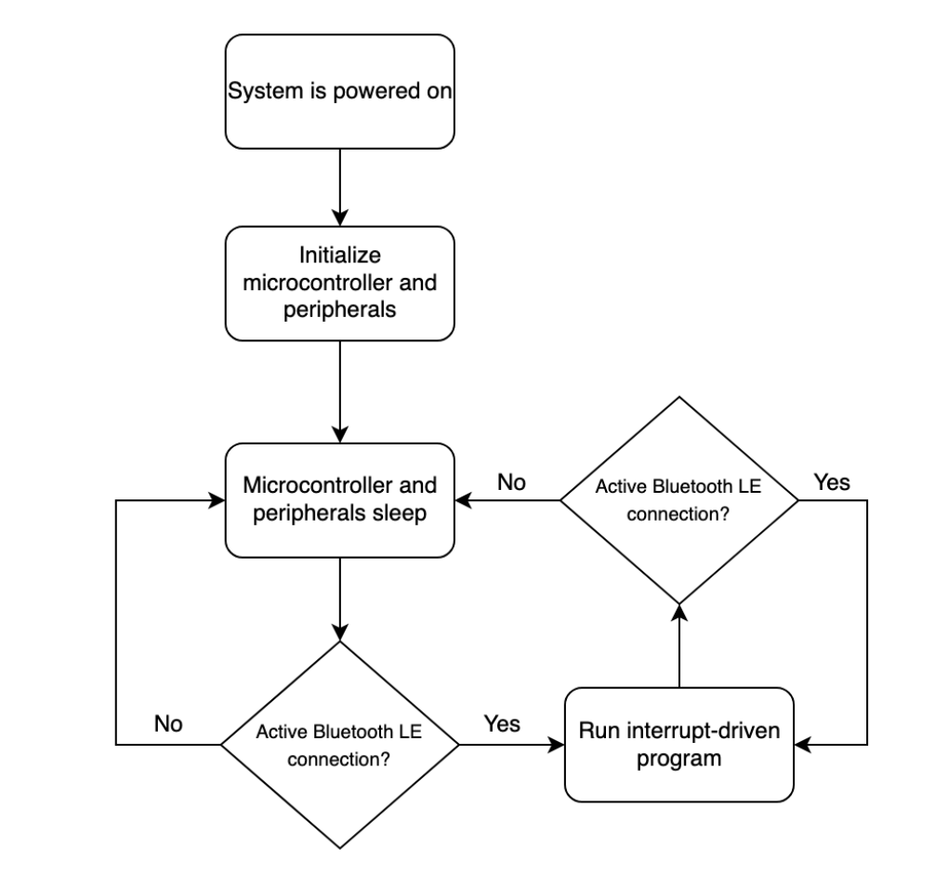
PIC18 software architecture
Application program developed in C with Microchip’s XC8 compiler
C compiled for PIC18 architecture
Uses an interrupt-based program to reduce power consumption
Microcontroller core sleeps when BLE connection is inactive
HM-10 module wakes up PIC18 core with external interrupt when a connection is active
Periodic update of battery voltage reading
~1 second timer interrupt
Data is only collected and sent in response to user requests
19200 baud serial communications used to communicate with HM-10, serial interrupt triggers a response
Makes use of on-chip hardware for interfaces to peripherals
UART: HM-10
I2C: LSM9DS1 (Sense Hat)
10-bit ADC: Battery level sensing
GPIO: Digital inputs and outputs for battery sense circuit, HM-10 digital interrupt

